Slide 1
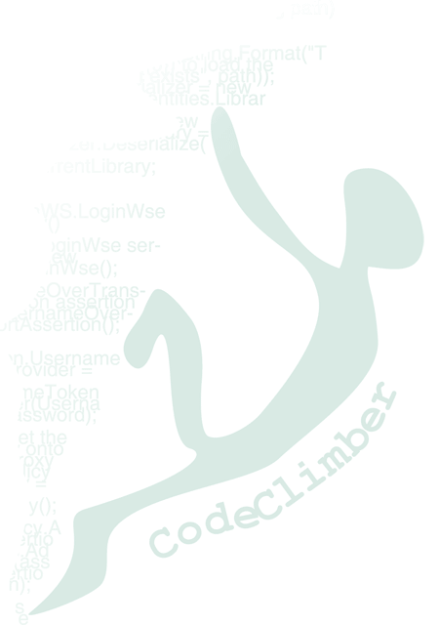



ASP.NET MVC Best Practices
Simone Chiaretta Solution Developer, Avanade
http://codeclimber.net.nz
Twitter: @simonech
21 Ottobre 2009

Slide 2





Thanks to the Sponsors

Slide 3
Who the hell am I?
Simone Chiaretta
Work for Avanade Italy
Microsoft MVP ASP.NET
Blogger – http://codeclimber.net.nz
Founder of UGIALT.NET
OpenSource developer
Climber
All Around Nice Guy

Slide 4
Agenda
ASP.NET MVC Best Practices
Would you like someone to tell you the final a movie before you watch it?

Slide 5
What ASP.NET MVC is?
It’s an advanced session... You should already know ☺

Slide 6
Just in case
The Controller asks the Model for data
The request hits the controller
Model
2
Browser
1
Controller
3
The Model gives the data back to the Controller
The controller formats the data and passes them to the View
4
View
5
The view renders the HTML that needs to be sent to the client

Slide 7
Controller

Slide 8
Delete “AccountController”
Best Practice n° 1

Slide 9
1 – Delete “AccountController”
You will probably never use these account management pages
Keeping demo code in a production application is EVIL
Delete it ☺

Slide 10
Isolate controllers from the external World
Best Practice n° 2

Slide 11
2 - Isolate controllers from the outside World
HttpContext
Data Access classes
Configuration management
Logging
Clock
Etc…

Slide 12
2 - Isolate controllers from the outside World
Not testable application
Not flexible application

Slide 13
Use a IoC Container
Best Practice n° 3

Slide 14
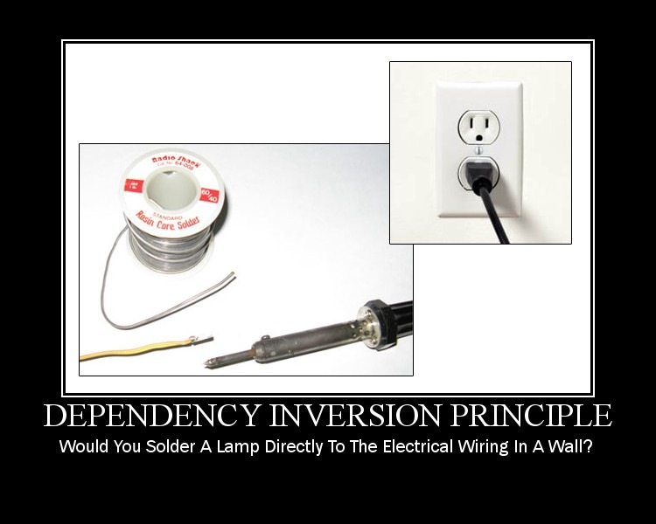
What’s Dependency Injection

Slide 15

What’s Dependency Injection
BAD

Slide 16

What’s Dependency Injection
BETTER

Slide 17

What’s Dependency Injection
BUT

Slide 18

Inversion of Control
With IoC

Slide 19
IoC inside ASP.NET MVC
Extend ControllerFactory
Many ControllerFactory ready available
StructureMap
Spring
Unity
Windsor
Ninject
...

Slide 20
IoC inside ASP.NET MVC using Ninject v2
Global.asax inherits from NinjectHttpApplication
Helper to configure all controllers:
RegisterAllControllersIn(“assemblyName”);

Slide 21
Don’t use “Magic strings”
Best Practice n° 4

Slide 22
Say NO to Magic Strings
Never use ViewData[“key”]
Always create a ViewModel for each View
View must inherit from
System.Web.Mvc.ViewPage<ListViewModel>

Slide 23
Build your own “personal” conventions
Best Practice n° 5

Slide 24
Build your own “personal” conventions
ASP.NET MVC is the base on which to build your own reference architecture
Controllers (and views) inherint from your own base class

Slide 25
Pay attention to Verbs
Best Practice n° 6

Slide 26
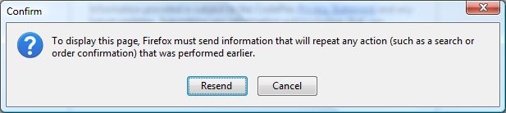
Pay attention to Verbs
What happens when you refresh (or go back) after you submit a form?

Slide 27
PRG Pattern
View sends data in POST
Controller validates
Renders the View with errors (POST)
Redirect in GET
View renders the results in GET

Slide 28
Pay attention to Verbs
Show data in GET
Modify data in POST

Slide 29
Model

Slide 30
DomainModel != ViewModel
Best Practice n° 7

Slide 31
DomainModel != ViewModel
DomainModel
Data + Behaviours
hierarchical, complex types
ViewModel
Only Data
Flat, only strings

Slide 32
DomainModel != ViewModel
How to avoid getting bored writing tedious mapping code?
AutoMapper
Mapper.Map<Post, ShowPostModel>(post)

Slide 33
Use ActionFilter for “shared” data
Best Practice n° 8

Slide 34
Components in ASP.NET MVC
RenderPartial
The Controller must “create” all data needed by all the partials
RenderAction (futures)
Smells (view calls a controller)
More difficult to test
Custom HtmlHelpers
Ok for some HTML, but must not have logic

Slide 35
Action Filtes
Defined as Attributi
Allow you to execute “code”
During the Autenthorization phase
If an exception occurs
Before an Action
After an Action
Before the rendering of a view
After the rendering of a view
“Core” filters
Authorize
OutputCache

Slide 36
Action Filter + Render Partial
Controller:
Has code for his “main concern” and “create” the main data
View:
Renders the main output
Calls the various PartialViews
Action Filters:
Load data for the partial views
Partial views
Render data loaded via Action Filters

Slide 37
View

Slide 38
Do NOT use code-behind
Best Practice n° 9

Slide 39
Do NOT use code-behind
NEVER

Slide 40
Write HTML when you can
Best Practice n° 10

Slide 41
Write HTML when you can
You MUST learn HTML
Do never use HtmlHelpers that ONLY abstract HTML awat
<%= Html.Submit(“Salva”) %>
vs
<input type=“submit” value=“Salva” />

Slide 42
If there is an if, write an HtmlHelper
Best Practice n° 11

Slide 43
If there is an if, write an HtmlHelper
View must not have logic
Allowed: if - foreach
When possible, “hides” them in HtmlHelpers

Slide 44
Choose your View Engine carefully
Best Practice n° 12

Slide 45
Choose your View Engine carefully
The default is WebFormViewEngine
Not the best available
Choose the one that most suits you

Slide 46
Choose your View Engine carefully
Spark View Engine
The flow is managed by HTML
It’s a templating engine
Other Features
Renders PDF
Evaluates templates also with Javascript

Slide 47
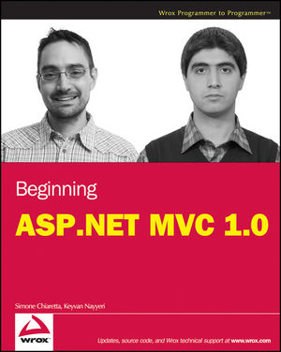
Beginning ASP.NET MVC
Simone Chiaretta & Keyvan Nayyeri
TOC:
MVC
Testing
And more...
http://bit.ly/BeginningASPNETMVC

Slide 48
Contacts – Simone Chiaretta
MSN: simone_ch@hotmail.com
Blog:
English: http://codeclimber.net.nz/
Italian: http://blogs.ugidotnet.org/piyo/
Twitter: @simonech

Slide 49
Credits
These talk has been inspired by Sebastien Lambla (founder of Caffeine IT) and his ASP.NET MVC Best Practices
Watch his talk (which is way better than mine): http://serialseb.blogspot.com/2009/05/my-mvc-best-practices-talk.html
Read his blog: http://serialseb.blogspot.com/

Slide 50
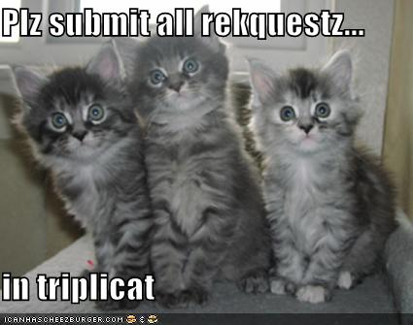
Q&A

